Slide 1

Understanding Training, Testing, and Validation Datasets in Machine Learning
Welcome to the exciting world of Machine Learning! Today, we'll discover how computers learn to make smart decisions using three special types of datasets.

Slide 2

What is Machine Learning?
Machine Learning (ML) is like teaching a computer to learn from examples, just like you learn math by practicing problems or improve at sports through repetition.
Instead of programming exact rules for every situation, we give the computer data so it can discover patterns and make predictions on its own.

Slide 3
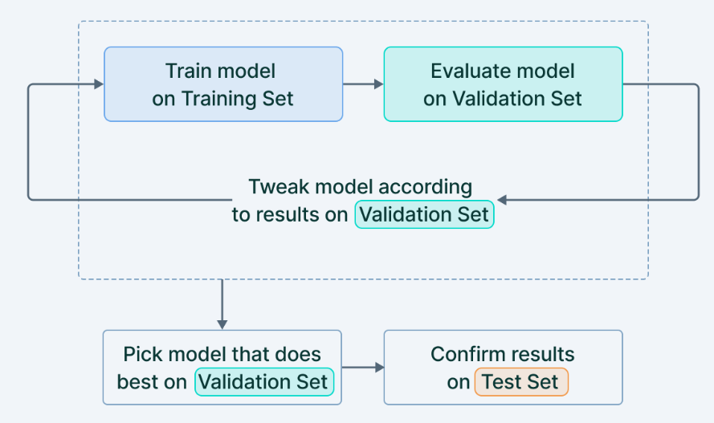
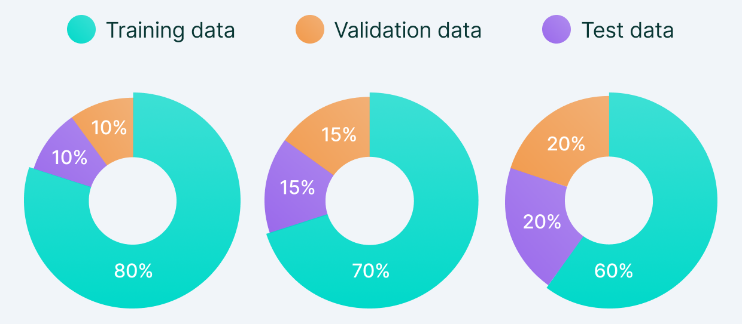
Training vs Test vs Validation Sets
Train the model using “training set”
Evaluate the model on “validation set”. Tweak the model as needed.
Finally, test your model with “Test set”
https://www.v7labs.com/blog/train-validation-test-set

Slide 4

Imagine Teaching a Robot to Recognize Fruits
01
02
03
Show Examples
Robot Learns
Test Understanding
You show the robot hundreds of pictures of apples and bananas from different angles
The robot learns patterns: apples are round and red, bananas are long and yellow
But how do we know if the robot truly learned, or just memorized?

Slide 5



Meet the Three Important Datasets
Just like studying for a test, machine learning uses different sets of examples for different purposes:
Training Dataset
Validation Dataset
Testing Dataset
The examples the robot studies and learns from, like your textbook and homework problems
Practice quizzes used to check progress and adjust learning strategies during training
The final exam with completely new examples to measure true understanding

Slide 6




Why Do We Need Three Datasets?
Training Only Problem
Robot might just memorize pictures instead of learning real patterns (called overfitting)
Validation Helps
Allows us to fine-tune the robot's learning and catch mistakes early
Testing Reveals Truth
Gives an honest, unbiased score of how smart the robot really is

Slide 7
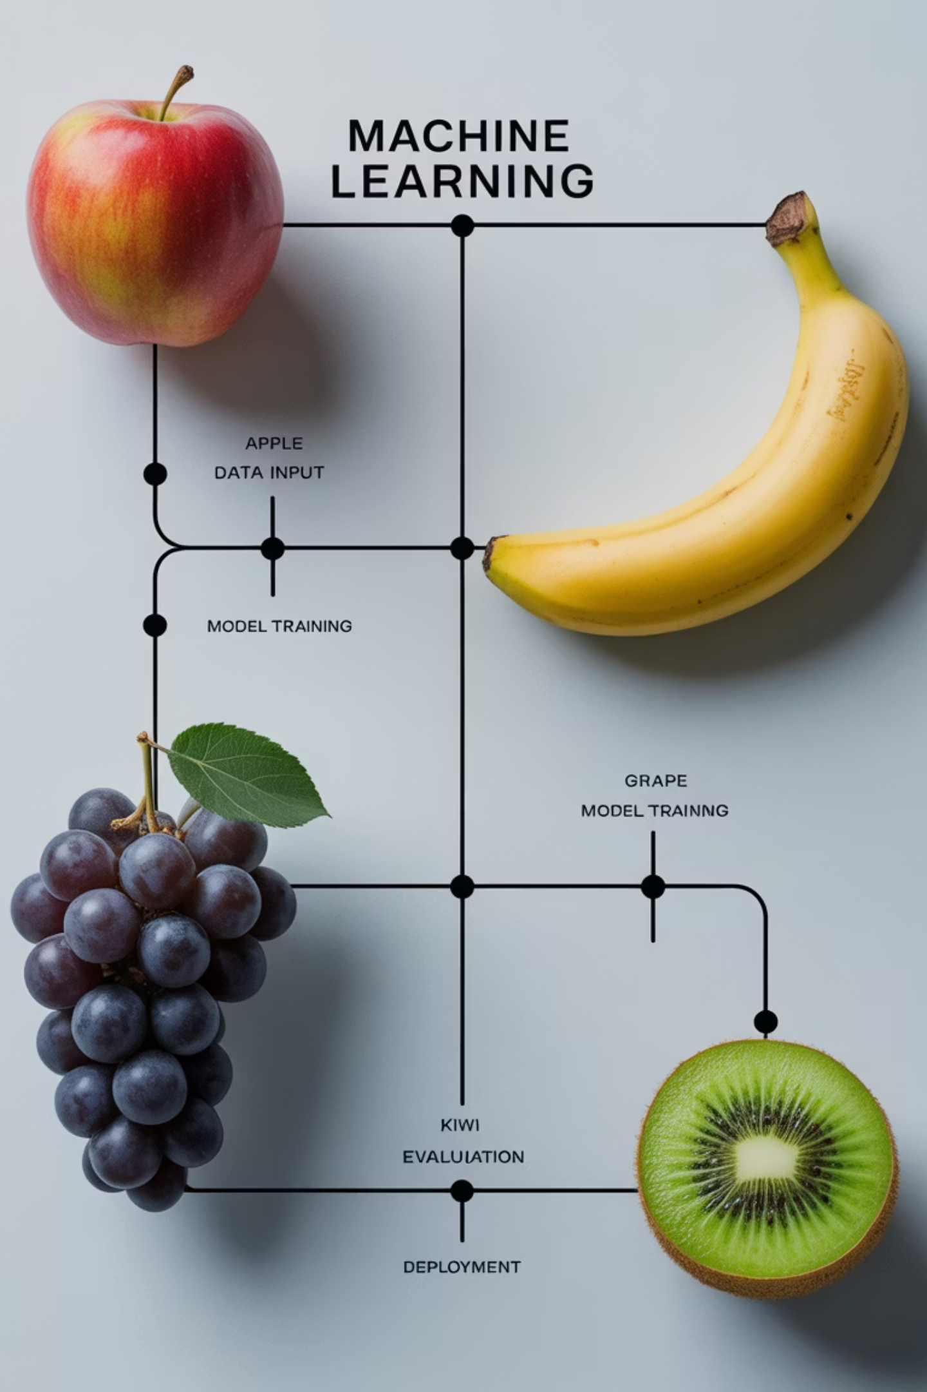
Visual Story: The Fruit Classifier Journey
1
Training Phase
Robot studies 100 pictures of apples and bananas, learning shapes, colors, and textures
2
Validation Phase
Robot tries classifying 20 new pictures, discovers mistakes, and adjusts its understanding
3
Testing Phase
Robot faces 30 brand new pictures it has never seen to prove its learning

Slide 8

Real-World Example: Netflix Movie Recommendations
1
Training Data
2
Validation Data
Netflix analyzes millions of movies you and others have watched and rated
Tests different recommendation algorithms to find which ones work best
3
Testing Data
Verifies recommendations work accurately for brand new users and movies

Slide 9
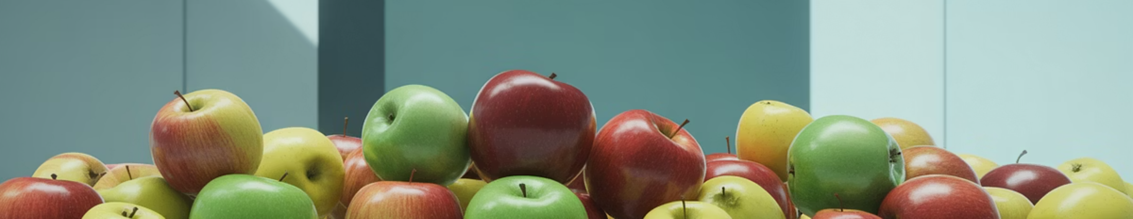
Fun Fact: Data Quality Matters!
The Red Apple Problem
Solution: Diversity
If training data only contains red apples, the robot might think all apples must be red and reject green apples!
Diverse and balanced data helps the robot learn accurate patterns and avoid bias. Include red apples, green apples, Granny Smiths, and Fujis!
Key Lesson: The quality and variety of your data is just as important as the quantity. Garbage in, garbage out!

Slide 10


Quick Quiz: Which Dataset?
The Challenge
You want to teach a computer to spot spam emails. You have 1,000 emails total: 700 for learning patterns, 150 to check progress, and 150 to test final performance.
Question: Which numbers represent training, validation, and testing datasets?
700
150
150
Training
Validation
Testing
Learning patterns
Checking progress
Final performance

Slide 11

Summary: Why It Matters
Smart Learning
Real-World Success
Training, validation, and testing datasets ensure computers learn intelligently, not just memorize
These datasets make sure ML models work reliably on new, unseen data in the real world
Your Future
Understanding these concepts empowers you to build your own amazing ML projects someday!
Now you're ready to explore the incredible world of Machine Learning. Who knows? Maybe you'll create the next breakthrough AI!

